Slide 1

DEPARTMENT OF COMPUTER SCIENCE AND ENGINEERING
PROJECT NAME: ENVIRONMENTAL MONITORING
TEAM NAME : Proj_224786_Team_3
TEAM MEMBERS:
HARIKEERTHI.S(113321104025)
HARITHA.D(113321104027)
HEMALATHA.S(113321104028)
JANANI.M.A(113321104030)

Slide 2
INNOVATION
Sensors: Internet of Things (IoT) devices are used to collect data on air quality, water quality, and other environmental factors in real time.
Machine Learning: ML algorithms analyze vast datasets to predict environmental trends, such as climate modeling and species population changes.
Remote Sensing Technologies: Satellite and drone-based remote sensing provide high-resolution data for monitoring changes in land use, deforestation, and more.
Citizen Science Apps: Smartphone apps empower citizens to participate in data collection and reporting on local environmental issues

Slide 3
PROJECT OBJECTIVE
1.Data Storage and Management:
Implement a database or cloud-based storage solution to securely store the incoming environmental data. Ensure data integrity, availability, and scalability.
2.Data Analysis and Visualization:
Develop analytical algorithms and visualization tools to process and present the collected data in a user-friendly format.
3.Alerting and Notifications:
Set up alerting mechanisms to notify relevant stakeholders when certain environmental thresholds or anomalies are detected.
4.Energy Efficiency:
Design the IoT devices and network to be energy-efficient to ensure long-term operation without frequent battery replacements or downtime.
5.Data Privacy and Security:
Implement robust security measures to protect the collected data from unauthorized access and ensure compliance with data privacy regulations.

Slide 4
6.Community Engagement: Involve local communities, government agencies, and environmental organizations to create awareness. 7.Environmental Impact Assessment: Use the collected data to assess the impact of human activities on the environment. 8.Research and Policy Support: Collaborate with researchers and policymakers to provide valuable data for scientific research and evidence-based decision-making in environmental policies. 9.Cost-Benefit Analysis: Evaluate the project's cost-effectiveness and potential economic benefits, such as improved public health or reduced resource wastage.

Slide 5
PROJECT REQUIREMENT
Temperature sensors
Air quality sensors
Gas sensors
Humidity sensors
Water quality sensors
Radiation sensors
Research and policy suppor

Slide 6
INTEGRATION
Integrating environmental monitoring with other disciplines and sectors is not a one-size-fits-all process, as the context, purpose, and scope of the project or program will dictate the approach.
However, some general steps and principles can guide the integration process.
This includes defining the problem or opportunity, identifying relevant disciplines and sectors, establishing a common framework and language for data collection and analysis, engaging stakeholders throughout the process, applying appropriate methods and tools to integrate data and outputs, evaluating outcomes and impacts, and sharing lessons learned.
These steps will help ensure a successful integration of environmental monitoring with other disciplines and sectors.

Slide 7
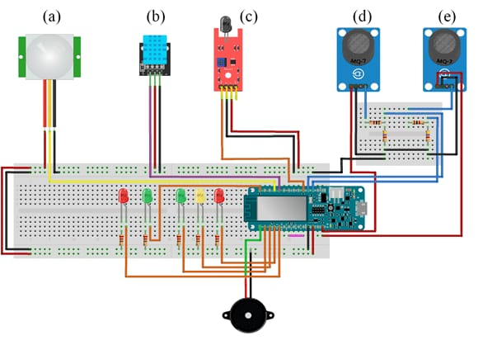
ARDUINO INTEGRATION

Slide 8
CODE IMPLEMENTATION
Import Adafruit_DHT
import time
# Set up the DHT11 sensor - GPIO pin 4
sensor = Adafruit_DHT.DHT11
pin = 4
while True:
try:
# Read data from the sensor humidity, temperature = Adafruit_DHT.read_retry(sensor, pin)
if humidity is not None and temperature is not None:
printf('Temperature: {temperature:.2f}°C, Humidity: {humidity:.2f}%')
else:
print('Failed to retrieve data from the sensor. Check your connections.')
# Wait for a specific interval (e.g., 5 minutes)
time.sleep(300)
except Keyboard Interrupt:
print('Monitoring stopped')
break

Slide 9
MOBILE APP DEVELOPMENT
Developing a mobile app for environmental monitoring using IoT can be a complex but rewarding project. Here are some key steps and considerations to get you started:
Define Your Objectives: Clearly outline what environmental parameters you want to monitor (e.g., air quality, temperature, humidity) and what actions you'll take based on the data.
Select IoT Devices: Choose appropriate sensors and IoT devices that can collect the necessary data. Ensure they are compatible with your chosen IoT platform.
Choose an IoT Platform: Select an IoT platform like AWS IoT, Azure IoT, or Google Cloud IoT to manage device connectivity, data processing, and security.
User Authentication and Security: Implement user authentication and ensure data security, as environmental data can be sensitive.
Offline Support: Consider providing offline access to historical data in case of connectivity issues.
Testing and Quality Assurance: Thoroughly test the app and IoT infrastructure to ensure data accuracy and reliability.
Compliance and Regulations: Ensure that your app complies with any relevant environmental regulations and data privacy laws.

Slide 10
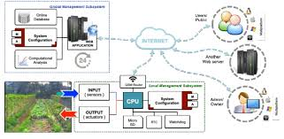
IMPLEMENTATION AND SIMULATION

Slide 11
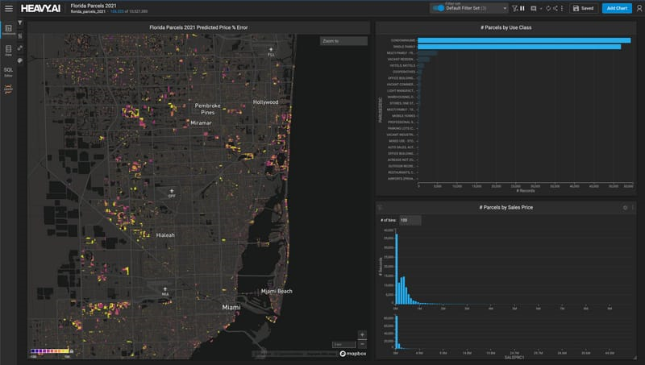
REAL TIME WEBSITE

Slide 12
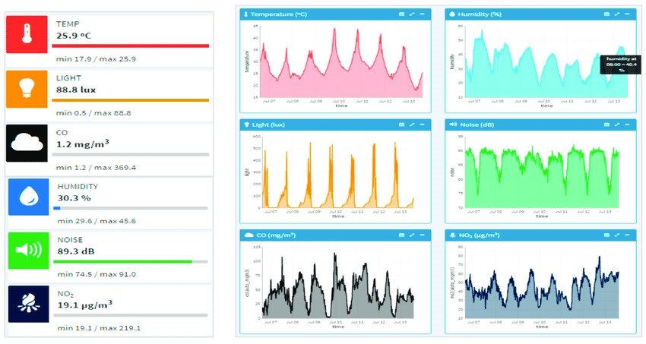

Slide 13
THANK YOU

